Slide 1
CAMARA EdgeCloud Meeting 9th January 2024

Slide 2
INSERT SUBHEADING
Agenda
Cleaning status of auxiliary branches
Harmonization of concepts/items among Simple Edge Discovery/MVP/Traffic Influence
Continuation on discussion PR159 With User stories
Minor changes on MVP EdgeCloud_LcM after approval of (PR 154)

Slide 3
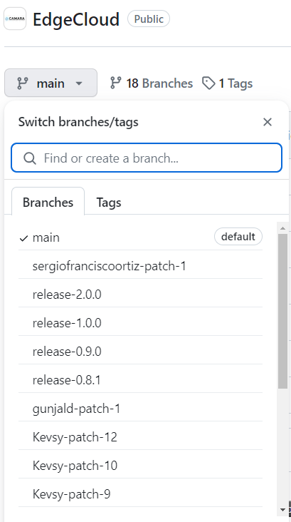
1.- Cleaning status of auxiliary branches

Slide 4
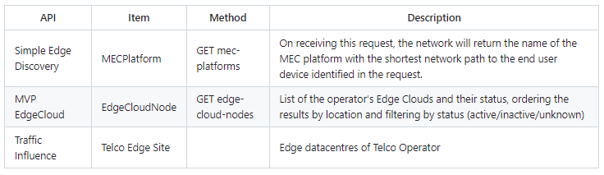
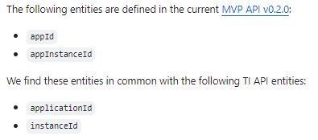
2.- Harmonization of concepts/items among Simple Edge Discovery/MVP/Traffic Influence
Issue 163 Harmonization of Edge Entitys among EdgeCloud APIS for future merge
Issue 164 TI and MVP API - Harmonization of common entities

Slide 5
3.- Other implementation details
Review discussion in PR PR 159
Continuation of discussion in previous meeting
Work pending in edge_terminology.md
User stories to clarify possible behaviours
Review of other topics from last comments in open pull requests

Slide 6
4.- Minor changes on MVP EdgeCloud_LcM after approval of (PR 154)
First pull request created: PR 165
Review of other topics from last comments in open pull requests

Slide 7
Backup

Slide 8
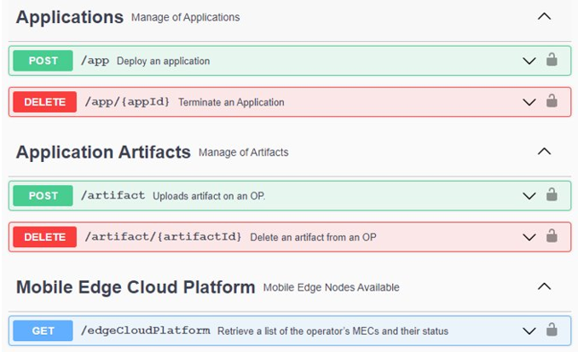
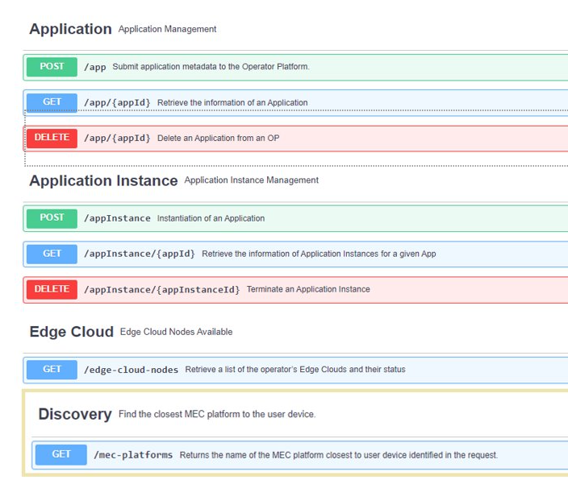
4.- Main changes in EdgeCloud MVP following.
Goal Merge into main branch and include further changes in separated PRs.
Combined Artifact and Application into a single type
Added get methods for Application and AppInstances ( included status for app instance)
V0.1.0
V0.2.0

